Slide 1

Global Citizenship & GLOBALIZATION
GNED 500
WEEK 2
Image by Pixabay.com

Slide 2
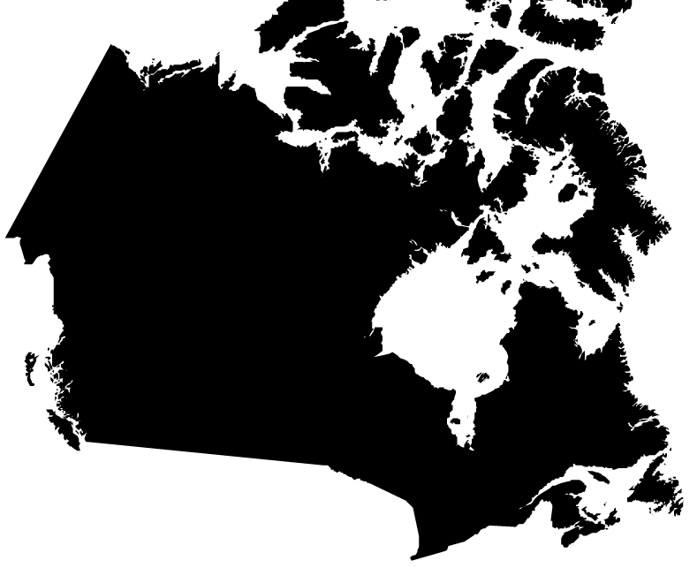
Acknowledgement
Traditional Lands
Canada Map Vectors by Vecteezy
Notes:
Acknowledgement of Traditional Lands
Centennial is proud to be a part of a rich history of education in this province and in this city.
We acknowledge that we are on the treaty lands and territory of the Mississauga’s of the Credit First Nation and pay tribute to their legacy and the legacy of all First Peoples of Canada, as we strengthen ties with the communities we serve and build the future through learning and through our graduates.
Today the traditional meeting place of Toronto is still home to many Indigenous People from across Turtle Island and we are grateful to have the opportunity to work in the communities that have grown in the treaty lands of the Mississauga’s.
We acknowledge that we are all treaty people and accept our responsibility to honor all our relations

Slide 3
AGENDA
UPDATE
REVIEW LAST CLASS
LEARNING OUTCOMES
GLOBAL CITIZENSHIP
GLOBALIZATION
GROUP ACTIVITY
Artwork by Hi Profile is licensed under a CC BY-NC-SA 4.0 International License.
Notes:
At its most basic level, Global Citizenship is the idea that we belong to a shared community of human beings.
This means that we think of ourselves not strictly as citizens of a particular nation, but as citizens of the whole world.
To understand the concept of global citizenship we need to begin with its foundations
First we need to consider: what is a citizen?

Slide 4

LEARNING OUTCOMES
At the end of this session, you will be able to:
Identify the different waves of globalization
Discuss different definitions of global citizenship
Examine the link between cosmopolitanism and multiculturalism to globalization
Compare and contrast globalization, global citizenship, and national citizenship
Understand the employability aspects of globalization and global citizenship
Image created by macrovector - freepik.com
Notes:
At its most basic level, Global Citizenship is the idea that we belong to a shared community of human beings.
This means that we think of ourselves not strictly as citizens of a particular nation, but as citizens of the whole world.
To understand the concept of global citizenship we need to begin with its foundations
First we need to consider: what is a citizen?

Slide 5

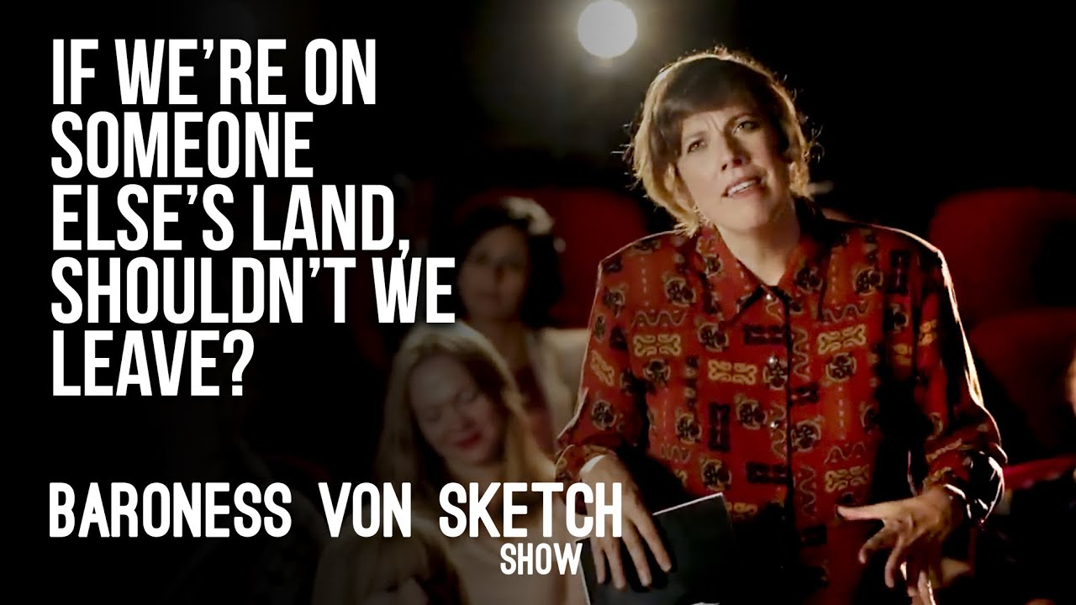
www.youtube.com/watch?v=xlG17C19nYo
Notes:
Land Acknowledgements
Although we do land acknowledgments lets think a little deeper on their meaning and why we do them
This video depicts a land acknowledgment that takes place at a theatre and the reaction of one of the audience members.
Using the form of comedy, this video asks a critical question about our responsibilities as citizens and residents of Canada.
It also demonstrates how studying global citizenship builds the knowledge and skills required to work towards more equal and just societies. (Source: CBC Comedy, 2019)
https: //www.youtube.com/watch?v=xlG17C19nYo

Slide 6

Global Citizenship
We belong to a shared community of humans
Think as citizens of the whole world
Global Citizenship Foundations?
First we need to consider:
what is a citizen?
By rawpixel.com freepik.com
Notes:
At its most basic level, Global Citizenship is the idea that we belong to a shared community of human beings.
This means that we think of ourselves not strictly as citizens of a particular nation, but as citizens of the whole world.
To understand the concept of global citizenship we need to begin with its foundations
First we need to consider: what is a citizen?

Slide 7

Citizenship
Citizenship = National Identity.
Acknowledgement of a belonging
To a particular country.
Belonging carries citizenship
Set of rights and responsibilities.
What are the Rights
and Responsibilities
of a Canadian citizen?
Photo by Cedric Fauntleroy from Pexels
Notes:
Citizenship usually denotes a national identity.
It is an acknowledgement of a belonging to a particular country.
And as part of that belonging, the citizen carries a specific set of rights and responsibilities.
Using Canada as an example, what are the rights and responsibilities of a Canadian citizen?
[possible activity/discussion]

Slide 8
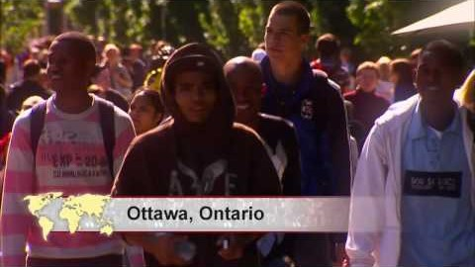

Notes:
https://youtu.be/IYIpLU2uhNA

Slide 9

Rights and Responsibilities
Rights:
Voting
Freedom of conscience and religion
Freedom of thought, belief, opinion, and expression
Freedom of peaceful assembly
Freedom of association
Responsibilities:
Voting
Obeying the law
Taking responsibility for oneself and one’s family
Protecting the nation’s heritage and environment
Defending Canada
Graphic created by upklyak - freepik.com
Notes:
Here are some of the rights and responsibilities of Canadian citizens-
Rights:
Voting
Freedom of conscience and religion
Freedom of thought, belief, opinion, and expression
Freedom of peaceful assembly
Freedom of association
Responsibilities:
Voting
Obeying the law
Taking responsibility for oneself and one’s family
Protecting the nation’s heritage and environment
Defending Canada

Slide 10
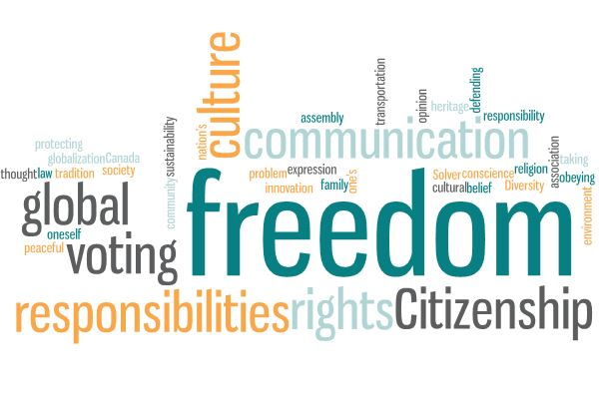
Rights and Responsibilities
How might we start to think of a global citizen?
Do you need to travel to be a global citizen?
Do you need to have friends or family in different countries?
Can you live in one location your whole life and still consider yourself a global citizen?
Let’s take a look at the person who is considered the first global citizen…
Artwork by Hi Profile is licensed under a CC BY-NC-SA 4.0 International License.
Notes:
If a national citizen has certain rights and responsibilities,
How might we start to think of a global citizen?
Do you need to travel to be a global citizen?
Do you need to have friends or family in different countries?
Or, can you live in one location your whole life and still consider yourself a global citizen?
To answer these questions, let’s take a look at the person who is often considered the first global citizen.

Slide 11
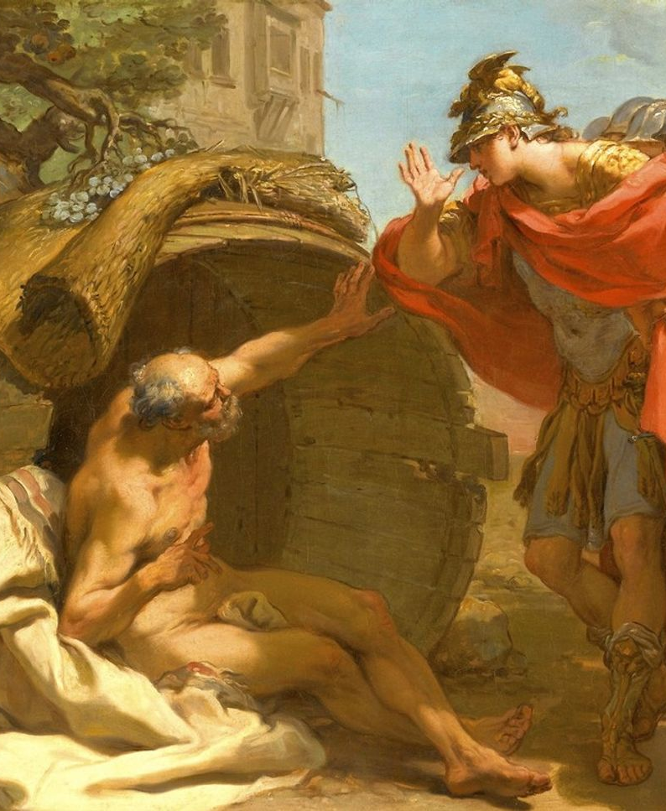
Diogenes
The Greek Philosopher Diogenes lived in a large clay pot in the marketplace of ancient Athens.
Although he was born in what is present day turkey, we might assume that he didn’t travel great distances.
We might assume that he didn’t have many possessions.
We might even assume that he didn’t have contact with many people outside of the local sphere, or city-state, in which he lived.
And yet, when Diogenes was asked where he was from, he replied, “I am a citizen of the world.”
Alexander and Diogenes|Gaetano Gandolfi, 1792 – Public Domain
Notes:
The Greek Philosopher Diogenes lived in a large clay pot in the marketplace of ancient Athens.
Although he was born in what is present day turkey, we might assume that he didn’t travel great distances.
We might assume that he didn’t have many possessions.
We might even assume that he didn’t have contact with many people outside of the local sphere, or city-state, in which he lived.
And yet, when Diogenes was asked where he was from, he replied, “I am a citizen of the world.”
https://commons.wikimedia.org/wiki/File:Gaetano_Gandolfi_-_Alexander_and_Diogenes.jpg

Slide 12
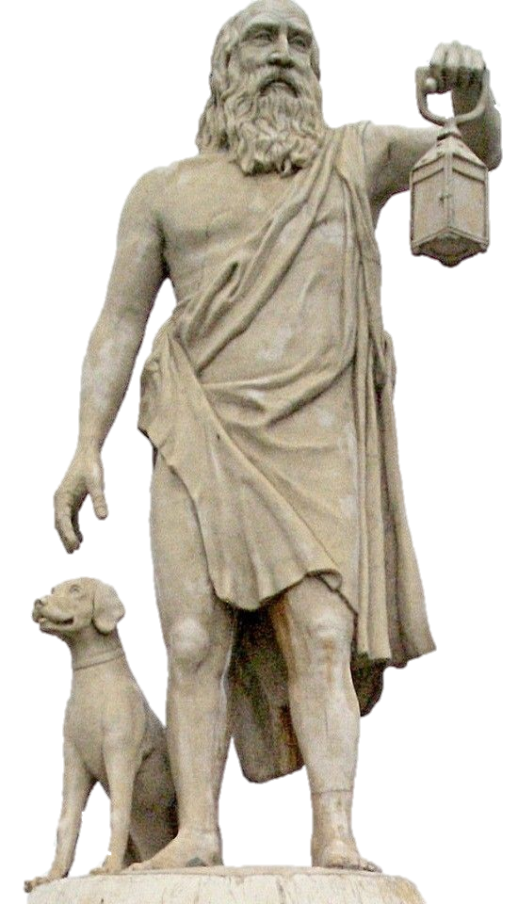
Diogenes
lived a life of poverty
Criticized corruption and injustice
Identified as a citizen of the world
Not claiming that he was worldly and sophisticated; he was staking out an ethical position.
Obligation to all of humanity.
Diogenes declared himself a cosmopolitan
Image by Michael F Schonitzer CC BY-SA 4.0
Notes:
Diogenes lived a life of poverty and he criticized corruption and injustice.
When Diogenes identified himself as a citizen of the world, he was not claiming that he was worldly and sophisticated; he was staking out an ethical position.
For Diogenes, being a citizen of the world meant that he had an obligation to all of humanity.
Diogenes declared himself a cosmopolitan or citizen of the cosmos.

Slide 13
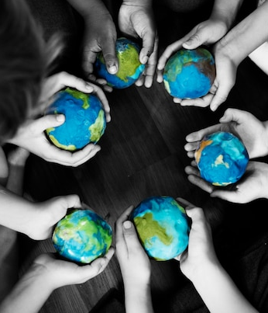
Cosmopolitanism
Global citizenship traced to cosmopolitanism.
A number of early thinkers have shaped this philosophy.
Diogenes, was one of its earliest thinkers in the 4th century BCE.
In the 17th century French philosopher, Voltaire
By rawpixel.com - freepik.com
Notes:
The roots of global citizenship can be traced to the philosophy of cosmopolitanism.
A number of early thinkers have shaped this philosophy.
Diogenes, as we mentioned, was one of its earliest thinkers in the 4th century BCE.
In the 17th century French philosopher, Voltaire,
said, “Cosmopolitans… regard all the peoples of the earth as so many branches of a single family, and the universe as a state, of which they, with innumerable other rational beings, are citizens, promoting together under the general laws of nature the perfection of the whole, while each in his own fashion is busy about his own well-being” (qt. in Appiah, 2006, p. xv).
PMBr1t4nn1c42022!

Slide 14
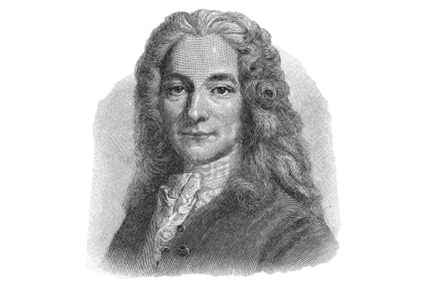
Cosmopolitanism
VOLTAIRE
“Cosmopolitans… regard all the peoples of the earth as so many branches of a single family, and the universe as a state, of which they, with innumerable other rational beings, are citizens, promoting together under the general laws of nature the perfection of the whole, while each in his own fashion is busy about his own well-being”
(qt. in Appiah, 2006, p. xv).
Image Public Domain Wikimedia
Notes:
The roots of global citizenship can be traced to the philosophy of cosmopolitanism.
A number of early thinkers have shaped this philosophy.
Diogenes, as we mentioned, was one of its earliest thinkers in the 4th century BCE.
In the 17th century French philosopher, Voltaire,
said, “Cosmopolitans… regard all the peoples of the earth as so many branches of a single family, and the universe as a state, of which they, with innumerable other rational beings, are citizens, promoting together under the general laws of nature the perfection of the whole, while each in his own fashion is busy about his own well-being” (qt. in Appiah, 2006, p. xv).

Slide 15
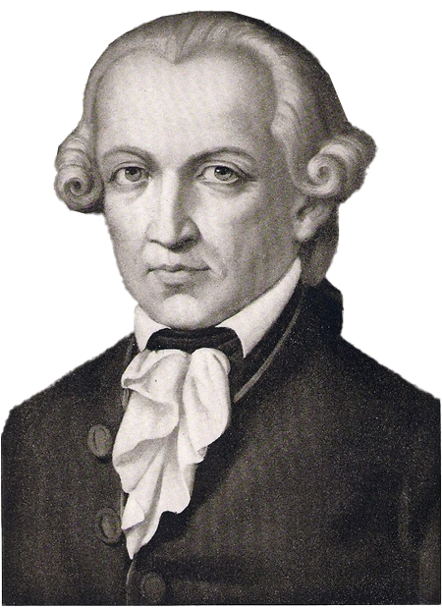
Cosmopolitanism cont’d
In the 18th century, the German philosopher Emmanuel Kant argued that all human beings have ‘intrinsic worth’ and a ‘dignity’ that must be respected.
The notion of universal hospitality as a right – “the right of a stranger not to be treated as an enemy.”
It is a right we have as fellow inhabitants of the earth.
Hospitality requires us to be kind and accommodating towards strangers.
Hospitality around the world.
KANT
Image Public Domain Wikimedia
Notes:
In the 18th century, the German philosopher Emmanuel Kant
Kant argued that all human beings have ‘intrinsic worth’ and a ‘dignity’ that must be respected.
Kant believed in the notion of universal hospitality as a right
– “the right of a stranger not to be treated as an enemy.”
According to Kant, it is a right we have as fellow inhabitants of the earth.
Hospitality requires us to be kind and accommodating towards strangers.
Hospitality around the world.
Image Public domain
https://en.wikipedia.org/wiki/Immanuel_Kant#/media/File:Immanuel_Kant_3.jpg

Slide 16
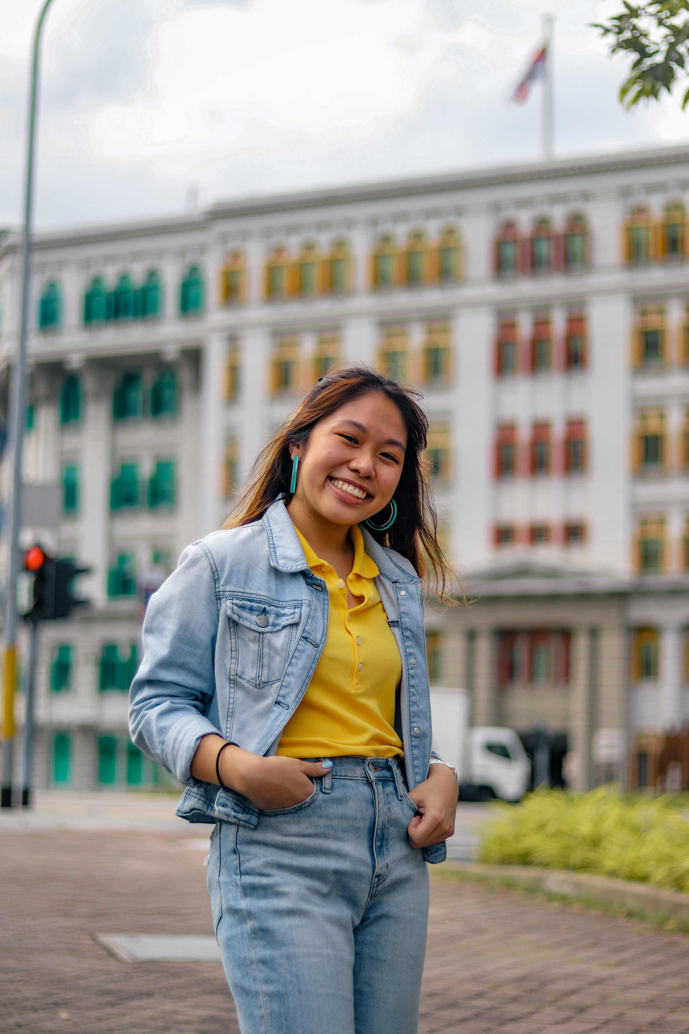
HOSP…
Hosp
Host
Hospice
Hospital
Hospitality
Hospitalize
Hospitalist
Hospitalism
ROOT of the word and sentiment
Treatment of a Guest or stranger
Photo by Joshua Tsu on Unsplash
Notes:
Roots: Hosp / Host : Latin : from hospes, hospit- meaning "host" and "guest“ Hospital: if you study the history of this word it was once a house for religious pilgrims and travelers, then a home for old people, and finally now a place where sick people go
Being someone who is hospitable is at the root of being a global citizen.

Slide 17
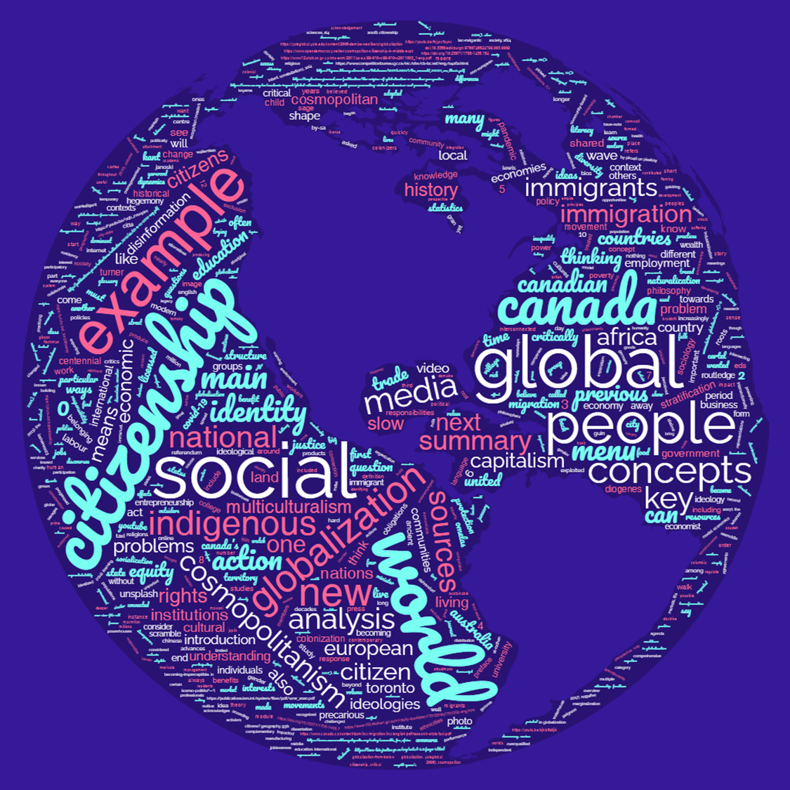
GLOBAL Citizenship
Global Citizenship is not a new concept.
It comes from a long tradition of thinkers dating back as far as the 4th century BCE.
New urgency and Ideology as the world moves more quickly and effectively than ever before.
Revival and return to the concept of global citizenship
Which is tied a phenomenon that characterizes the world in which we live today
– Globalization.
Artwork by Hi Profile is licensed under a CC BY-NC-SA 4.0 International License.
Notes:
What all of this reveals is that Global Citizenship is not a new concept.
It comes from a long tradition of thinkers dating back as far as the 4th century BCE.
But it takes on a new urgency in a time where improvements in transportation, technology, and telecommunications allow us to move ideas, people, and materials around the world more quickly and effectively than ever before.
There has been a revival and return to the concept of global citizenship, which is tied a phenomenon that characterizes the world in which we live today – Globalization.

Slide 18

BREAK
Photo by Angela Roma from Pexels.com
Notes:
15 Minute Break
This slide can be moved to where you have your class break(s)

Slide 19
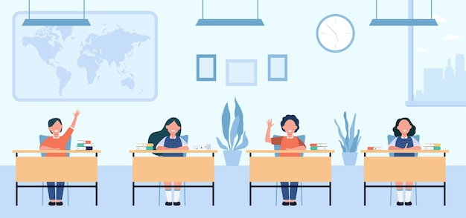

ATTENDANCE
ATTENDANCE MATTERS
Image by pch.vector - freepik.com
Notes:
This attendance slide can be moved to wherever in your class that you take attendance.
Usually attendance is taken around class breaks, or at the beginning or at the end of class.

Slide 20
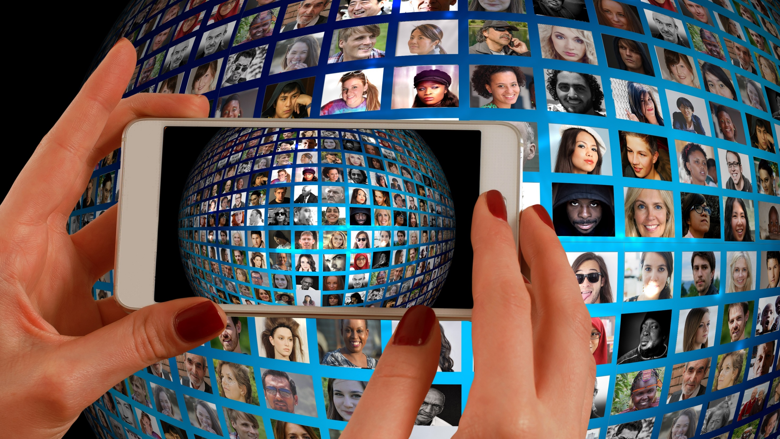
GLOBALIZATION
Image by Gerd Altmann from Pixabay

Slide 21
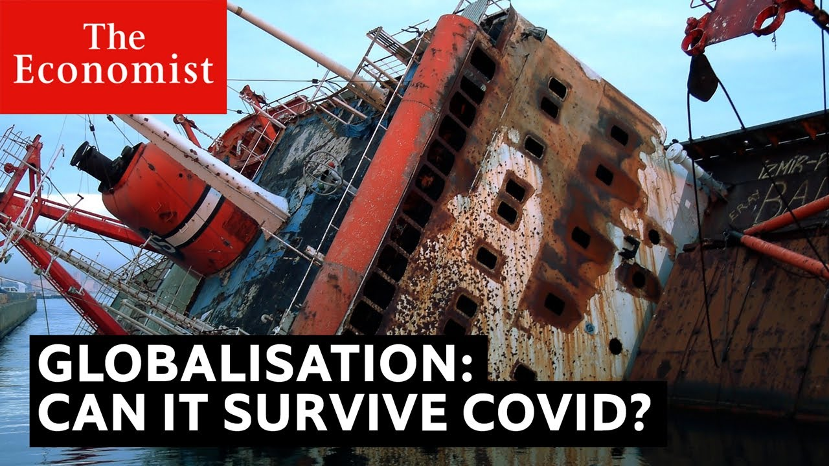
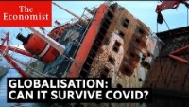
Notes:
https://youtu.be/KJhlo6DtJIk
The pandemic has changed our lives in countless ways.
But will COVID-19 spell the end of globalization?
Watch the video from The Economist called Will Covid-19 Kill Globalization?
Find out if we are nearing the end of an era.
(Source: The Economist, 2020)

Slide 22
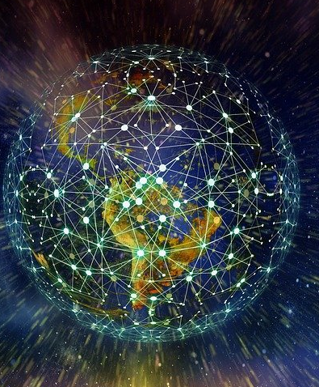
Globalization
What comes to mind when you hear the term globalization?
Menti.com – CODE: 4896 0796
What things do you have access to that could be thought of as the result of globalization?
Do you see globalization primarily as
positive phenomenon?
negative phenomenon?
Image by Gerd Altmann from Pixabay
Notes:
What comes to mind when you hear the term globalization?
What things do you have access to that could be thought of as the result of globalization?
Do you see globalization primarily as a positive or negative phenomenon?

Slide 23
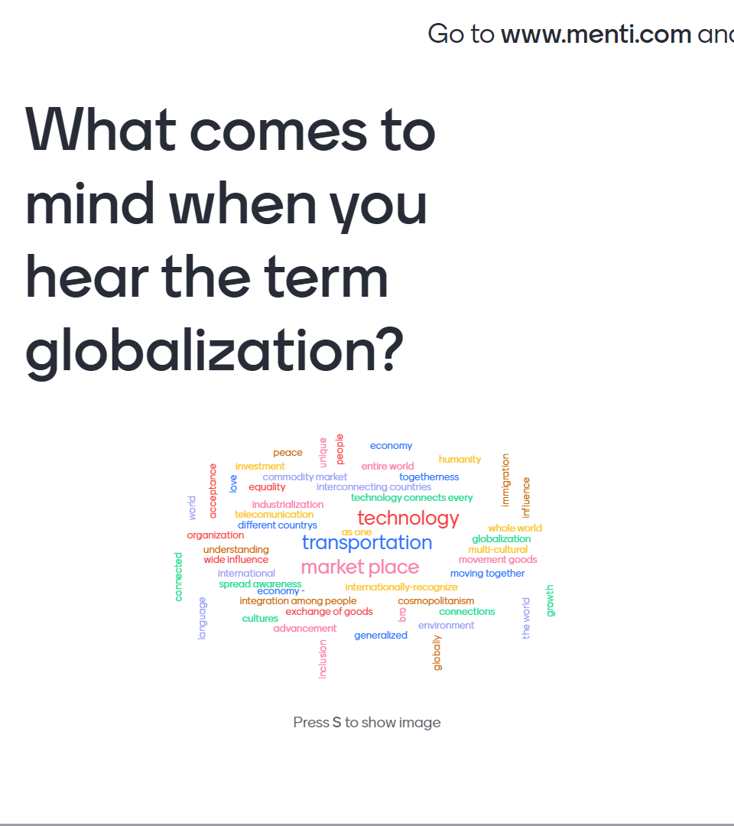
Image by Gerd Altmann from Pixabay

Slide 24

Globalization
Globalization refers to the increasing integration of nations’ economies, trade, products, ideas, norms, and cultures.
Movement of …
Transportation
Telecommunications
People
Image by Gerd Altmann from Pixabay
Notes:
Globalization refers to the increasing integration of nations’ economies, trade, products, ideas, norms, and cultures.
Rapid and dramatic improvements in transportation and telecommunications over the last 100 years has meant that ideas, people, and products can move around the world more quickly and effectively than was previously imagined.
Globalization Activity

Slide 25
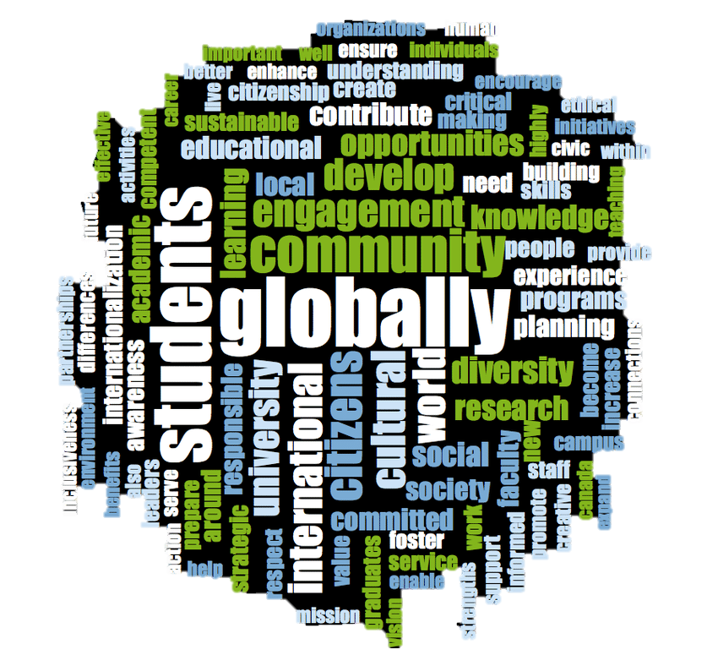
Globalization
Globalization has become a one-word-fits-all concept.
Put simply, it acknowledges that we are becoming increasingly connected economically, culturally, and politically.
We can see this shift in our everyday lives.
Artwork by Hi Profile is licensed under a CC BY-NC-SA 4.0 International License.
Menti.com
Notes:
Globalization has become a one-word-fits-all concept.
Put simply, it acknowledges that we are becoming increasingly connected economically, culturally, and politically.
We can see this shift in our everyday lives.

Slide 26
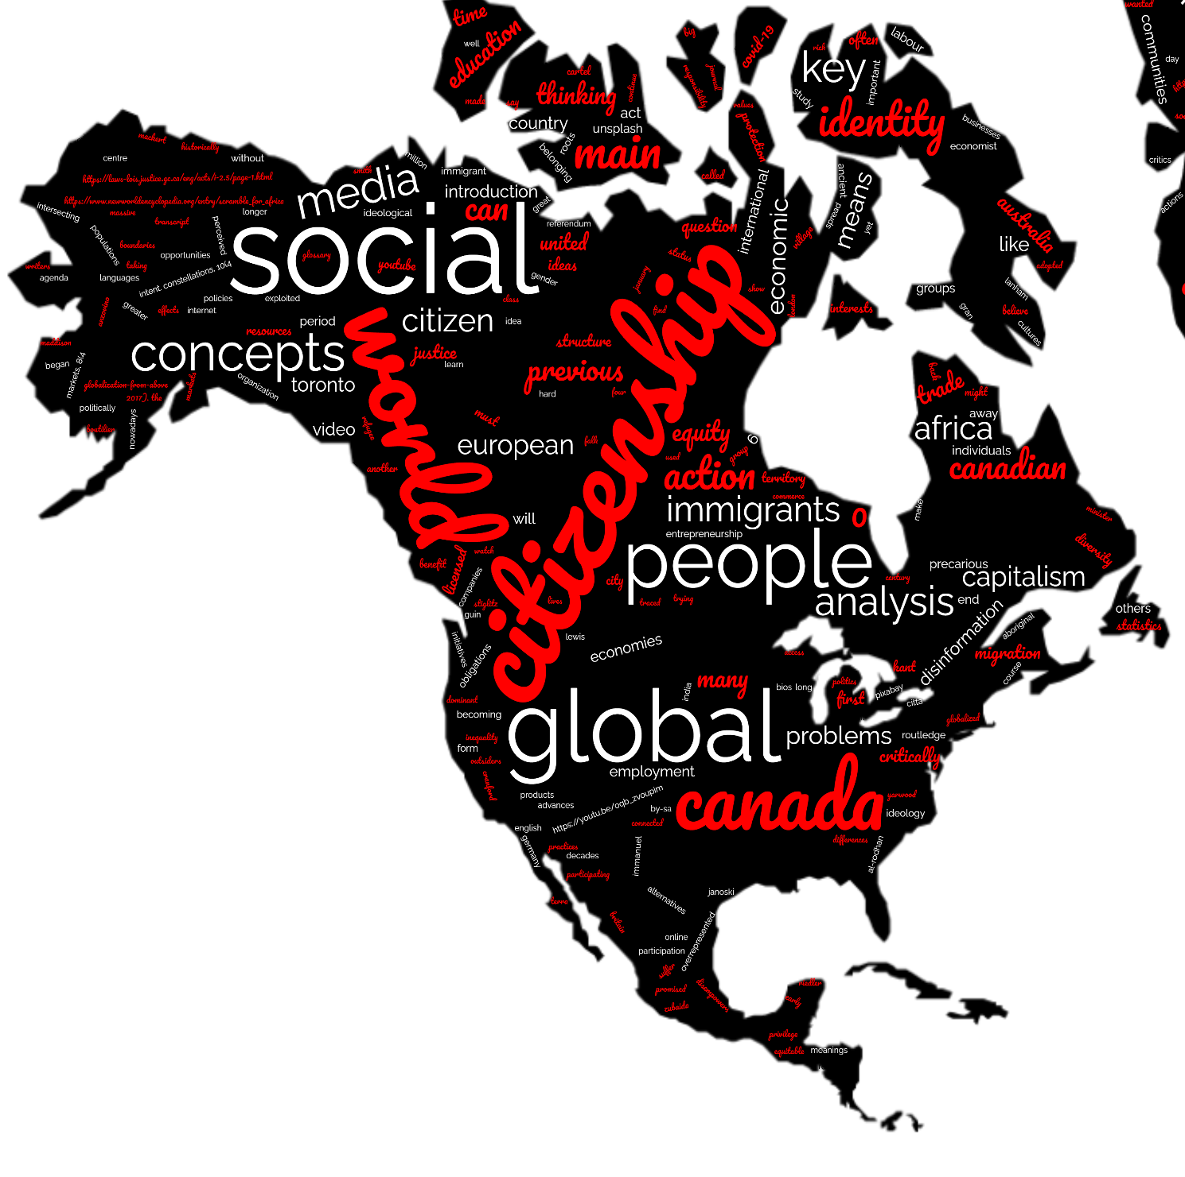
Globalization
At the start of the 20th century, colonial states like Canada put in place laws and policies to regulate perceived threats.
In Canada, these “threats” included Indigenous Peoples, Japanese and Chinese labourers, and mixed-raced populations.
Artwork by Hi Profile is licensed under a CC BY-NC-SA 4.0 International License.
Notes:
At the start of the 20th century, colonial states like Canada put in place laws and policies to regulate perceived threats.
In Canada, these “threats” included Indigenous Peoples, Japanese and Chinese labourers, and mixed-raced populations.

Slide 27
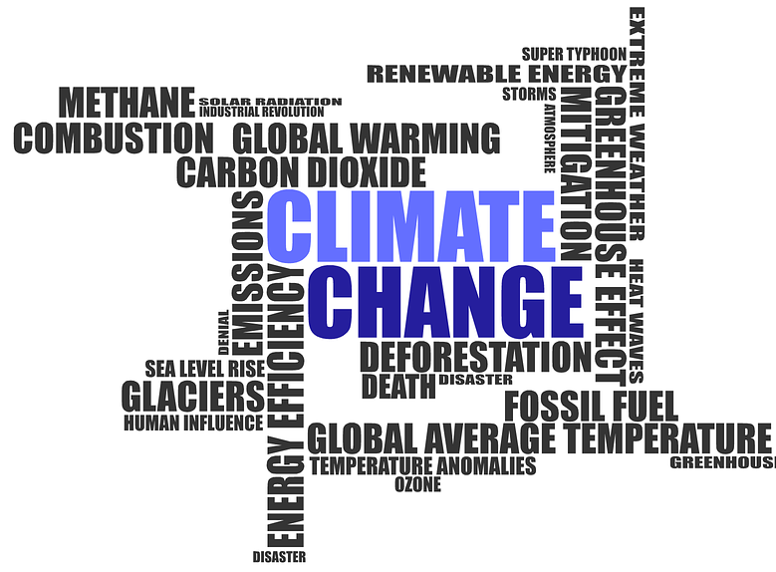
Global Citizenship in an era of Globalization
Globalization has benefited our lives, however no guarantee that it will improve our lives
In subsequent units, we will explore some of the human, environmental, and economic costs of our increasingly interconnected world.
Globalization contains no moral imperative to deal with societal issues
Global citizenship, on the other hand, requires an ethical and moral commitment to principles of fairness and justice.
Image by Darwin Laganzon from Pixabay
Notes:
While globalization has benefited our lives in many ways, there is no guarantee that it will improve our lives or the lives of others.
In subsequent units, we will explore some of the human, environmental, and economic costs of our increasingly interconnected world.
Globalization contains no moral imperative to deal with these issues in a way that respects and engages the rights and responsibilities of all of us.
Global citizenship, on the other hand, requires an ethical and moral commitment to principles of fairness and justice.

Slide 28

BREAK
Photo by Kevin Menajang Pexels.com
Notes:
15 Minute Break

Slide 29
ATTENDANCE
ATTENDANCE MATTERS
Image by pch.vector - freepik.com
Notes:
This attendance slide can be moved to wherever in your class that you take attendance.
Usually attendance is taken around class breaks, or at the beginning or at the end of class.

Slide 30
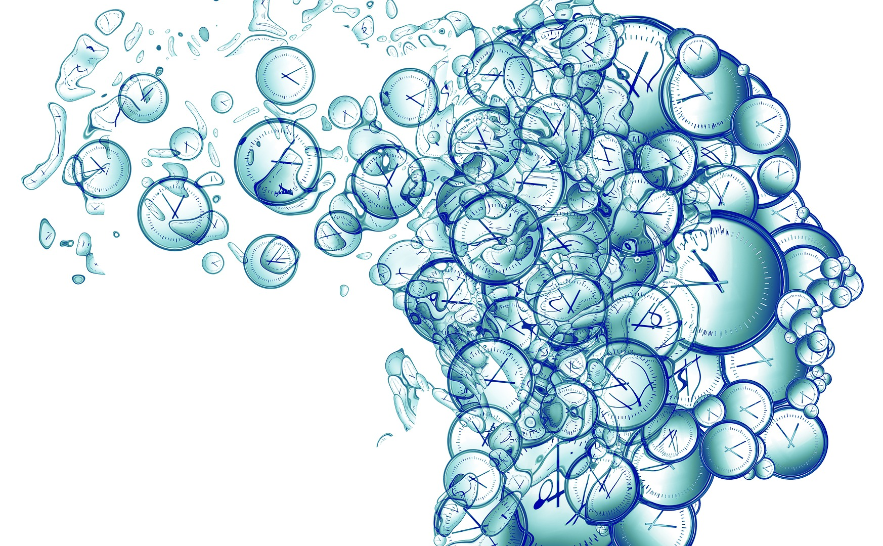
TIME TRAVEL GROUP ACTIVITY
"If you were able to travel through time, either forward or backward... :
Where would you go?
If backward, to which time period? Why?
If there was a person you could go back in time and meet, who would it be, and why?
Would you just want to visit and come back, or would you stay?"
How are things different then compared to now in terms of Globalization?
Each person must present someone different from your group
Time Clock Head by Pixabay
Notes:
"If you were able to travel through time, either forward or backward... :
Where would you go?
If backward, to which time period? Why?
If there was a person you could go back in time and meet, who would it be, and why?
Would you just want to visit and come back, or would you stay?"
How are things different then compared to now in terms of Globalization?
Each person must present someone different from your group

Slide 31


QUESTIONS
Question Marks created by Starline - freepik.com
Notes:
Questions …

